Slide 1
Java & Raspberry pi
A demo on how to put these together
Valentin Grégoire
Notes:
Introduce myself!
All know what Java is, but RasPi? A quick survey by show of hands: Who knows what a Raspberry Pi is?
For thos who don’t, *click*.

Slide 2
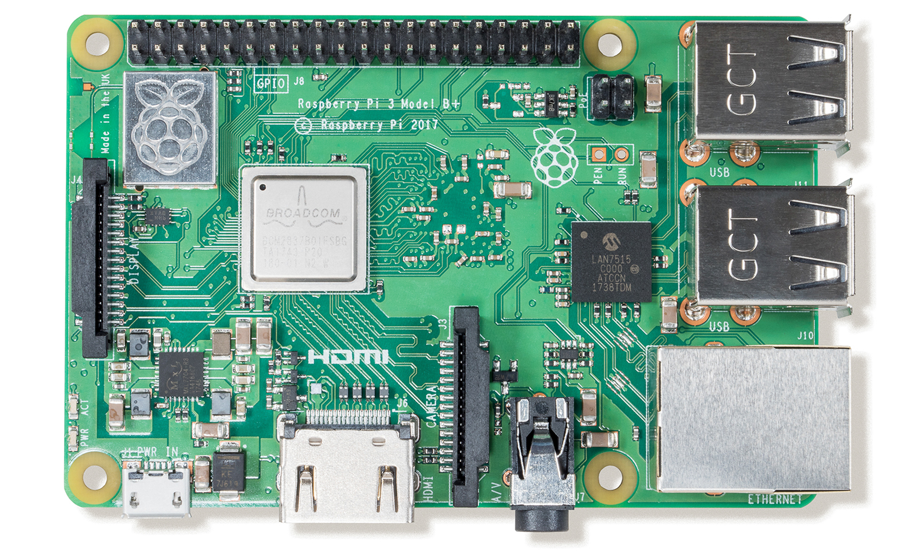
€ 40.00
Notes:
This is the model 3 B+ (most recent)
Low cost, credit-card sized computer
CPU: 1.4GHz 64-bit quad-core ARM Cortex-A53
RAM: 1GB LPDDR2 SDRAM.
Networking: Gigabit Ethernet (via USB channel), 2.4GHz and 5GHz 802.11b/g/n/ac Wi-Fi
Bluetooth: Bluetooth 4.2, Bluetooth Low Energy (BLE)
Storage: Micro-SD
GPIO: 40-pin GPIO header
Ports: HDMI, 3.5mm analogue audio-video jack, 4x USB 2.0, Ethernet, Camera Serial Interface (CSI), Display Serial Interface (DSI)
Default OS: Raspbian Strecth (version 9) -> Debian based -> Linux
All these components make a computer. For *click* around 40 euro, that’s a bargain, right?

Slide 3
Raspberry Pi 3 B+ Overview
Low cost, credit-card sized computer
CPU: 1.4GHz 64-bit quad-core ARM Cortex-A53
RAM: 1GB LPDDR2 SDRAM.
Networking: Gigabit Ethernet (via USB channel), 2.4GHz and 5GHz 802.11b/g/n/ac Wi-Fi
Bluetooth: Bluetooth 4.2, Bluetooth Low Energy (BLE)
Storage: Micro-SD
GPIO: 40-pin GPIO header
Ports: HDMI, 3.5mm analogue audio-video jack, 4x USB 2.0, Ethernet, Camera Serial Interface (CSI), Display Serial Interface (DSI)
Default OS: Raspbian Strecth (version 9) -> Debian based -> Linux -> This demo uses Raspbian Stretch Lite -> No desktop
Notes:
Extra info slide.

Slide 4
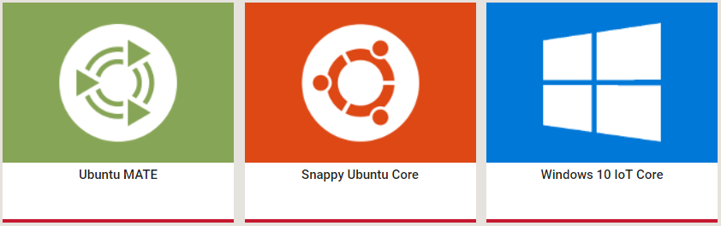
Pi as server for Java
Choose an OS (Raspbian, Snappy Ubuntu, Windows 10 IoT Core, ...)
Install JRE, Maven, GIT, ...
Notes:
Now, how to combine Java and Raspberry pi?
Since it’s a Linux computer, it can be used to serve our Java apps.
How to prepare your Rasperry Pi to behave as a server for your Java apps?
Choose an OS to your liking. I use Raspbian Stretch Lite -> No user interface! Many more...
Install everything you need to get your Java app started (JRE, Maven, GIT, ...)

Slide 5
Your Java App
Example Spring Boot app with one endpoint: GET http://localhost:8080/raspi/blink ➔ Raspberry Pi serves our Java app.
Install WiringPi: http://wiringpi.com/
Add the Pi4J dependency: https://pi4j.com/
<dependency> <groupId>com.pi4j</groupId> <artifactId>pi4j-core</artifactId> <version>1.2</version> </dependency>
Notes:
Example Spring Boot app created with the Spring Initializr (Spring Web added). Holds one endpoint.
If I package this code and upload it to my Pi and run it there, the Pi is actually a server running our Java app.
For full potential of the Raspberry Pi, we want to use the GPIO pins! ➔ Add Pi4J library and WiringPi!
Install WiringPi. GPIO access library for Raspbian. I’ve done this already on my Pi to save time since I got only 15 minutes.
Add the Pi4J project to your app. Internally, Pi4J uses WiringPi.

Slide 6
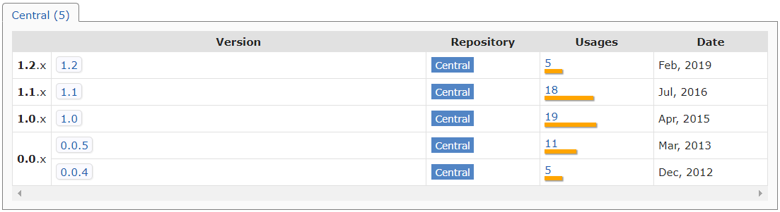
Pi4J SNAPSHOT
Side note: SNAPSHOT version perhaps required (manual build might be necessary).
Notes:
When we look at mvnrepository.com, it takes a while for new versions to be released.
SNAPSHOT repository on Pi4J website, but wasn’t up to date.
In the past.... Manual build!

Slide 7
Your Java App
Write some code to blink LED:
GpioController gpio = GpioFactory.getInstance(); GpioPinDigitalOutput ledPin = gpio.provisionDigitalOutputPin(RaspiPin.GPIO_01); ledPin.toggle(); gpio.shutdown(); gpio.unprovisionPin(ledPin); return "The led is now " + (ledPin.isHigh() ? "on" : "off") + "!";
Notes:
Hello world means blinking a led for a micro controller.
We create a GpioController
We Register GPIO_01 as a output pin.
We toggle the state of the pin where the LED is connected to.
We shut down our GpioController.
We unregister our GPIO_01 pin as an output pin.
And finally, we return if the led is on or off.
Empty example project and complete project are on my github: https://github.com/valentingregoire

Slide 8
Java & Raspberry pi
The end
https://github.com/valentingregoire
Valentin Grégoire
Notes:
So, in an easy way we can control an LED and who know what more we could do with this. An example of what I have done with it is at my job. We have an API of our application. As soon as a support ticket is submlitted through the application, an LED blinks at our office.
So, that’s how you use Java with a Raspberry Pi. Thanks for your attention!
Both the empty example project which I started from and the complete project are on my github.

